Slide 1
Text Summarizer
Sai Teja Ankam
Mentor : Narendra
Intern at Springboard Internship

Slide 2
Introduction
Introduct on
This project focuses on developing text summarization models using both abstractive and extractive approaches.
It condenses large volumes of information into shorter, readable summaries
Datasets used
CNN/Daily mails (For extractive)
Xsum (For Abstractive)
Sai Teja Ankam @saiteja

Slide 3
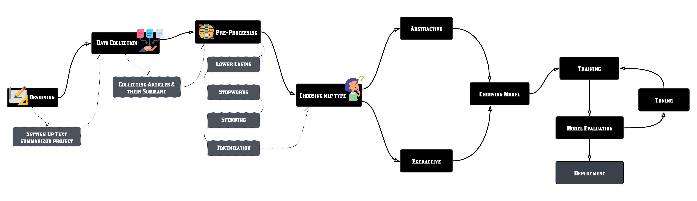
Work Flow
Sai Teja Ankam @saiteja

Slide 4
Types of summarization
Extractive Summarization
Abstractive Summarization
Extractive summarization involves selecting significant sentences, phrases, or sections directly from the source text and concatenating them to form a summary.
Abstractive Summarization generates new sentences that convey the most critical information from the source text
Let’s go with Extractive summarization first
Sai Teja Ankam @saiteja

Slide 5
Extractive summarization
Challenges
Initially, we chose the ‘bert-base-uncased’ model and tokenizer for extractive summarization
Despite careful preprocessing, the model encountered errors during training. These errors persisted even after several attempts to troubleshoot and resolve them.
After spending three days troubleshooting without success, we concluded that continuing with this model might not be the best approach.
Sai Teja Ankam @saiteja

Slide 6
Model transition
Bert
T5-small
T5-small is known for its efficiency and performance even on smaller hardware setups. T5 (Text-To-Text Transfer Transformer) is a versatile model designed to handle various text-to-text tasks, including summarization.
We decided to switch to a different model. We chose the ‘t5-small’ model.
After switching to t5-small we managed to train the model without any errors
Sai Teja Ankam @saiteja

Slide 7
Rouge-score
Performance

Slide 8
Abstraction summarization
Choosing Model
For the abstractive summarization task, we again used the ‘t5-small’ model, given its suitability and our familiarity with it.
Dataset
XSum Dataset (click to view)
Sai Teja Ankam @saiteja

Slide 9
After Fine-tuning
Problems solved after fine-tuning
Data split
Uploading model to drive
After training the performance is not up to the mark
So I decided to train number of times
As per my PC it won’t hold 100% of the data so I had to split it into 12000 records
Uploaded the model to drive for backup
Click here to see
Sai Teja Ankam @saiteja

Slide 10
Rouge
score

Slide 11
Interface
Integrating Models
Why Django?
Integrated both the models in Django web application
Gave simple user-friendly design for better experience
At my previous internship, I worked as Django developer, so it was easy for me to create robust web applications even with the large models
Sai Teja Ankam @saiteja

Slide 12
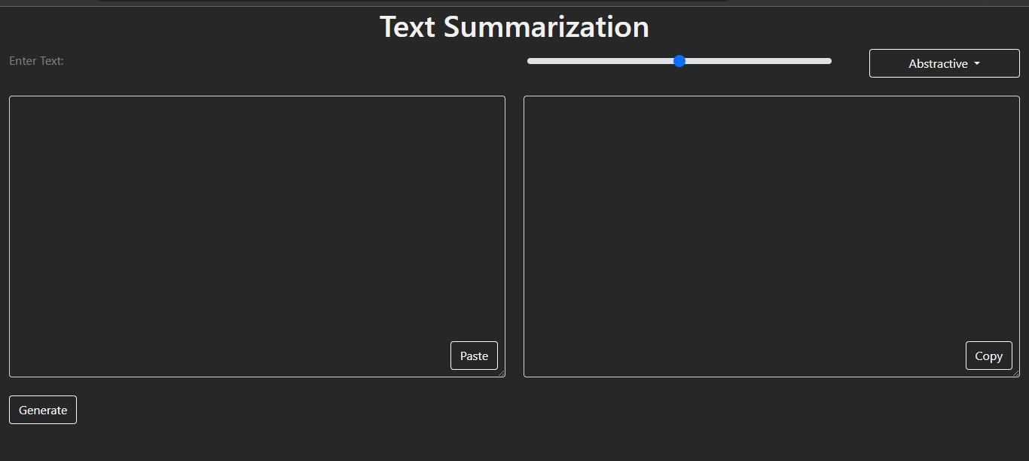
Features
UI Features
Copy paste buttons
Dropdown menu for selecting types of summarization
Range for length of the output
Sai Teja Ankam @saiteja

Slide 13

Deployment
AWS EC2
Deployed the web app in ec2 instance
To access the web app click below link
Text_summarizer
Sai Teja Ankam

Slide 14
Thank You
Sai Teja Ankam
https://saitejasa.pythonanywhere.com/
ankamsaiteja16@gmail.com
Sai Teja Ankam @saiteja

